Slide 1

Telecom Churn Analysis
Group No. 9
Team Members:
Venkata Sai Pavan Teja Angina
Shivaprasad G
Akhil Anilkumar
Arun Sv
Sahil Kumar Meher
Under Esteemed Guidance of
Ms. Pranita Mahajan

Slide 2
Brief Overview
Churn Prediction is one of the most popular Big Data use cases in Business. It consists of detecting customers who are likely to cancel a subscription a service.
Churn is a problem for telecom industries because it is more expensive to acquire a new customer than to keep your existing from leaving.
NOTE :- Telecom Industry today measure voluntary churn by a monthly figure, such as 1.9 or 2.1 percent.

Slide 3
Project Objective
To predict customer churn.
Highlighting the main variables/factors influencing the customer churn.
Use of various ML Classification algorithms to build prediction models, evaluate the accuracy and performance of these models.
Finding out the best model for the given dataset.

Slide 4
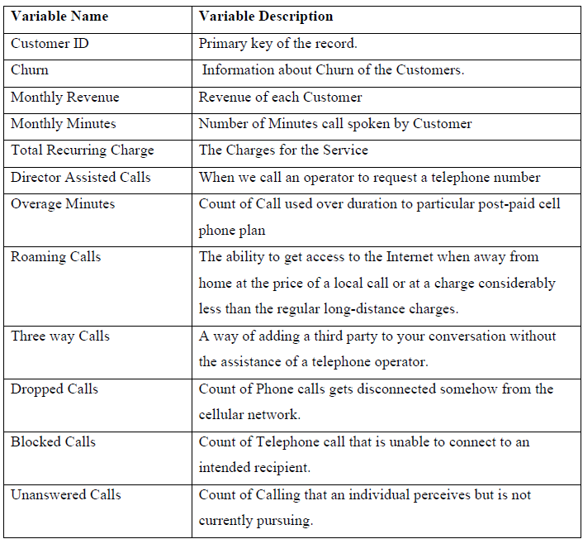
Dataset Information
Data is taken from Kaggle (Telecom churn Dataset)
No. of features: 58
No. of records: 51047
Target Column: Churn
Redundant columns: Customer Id, Service area.
No. categorical columns : 21

Slide 5
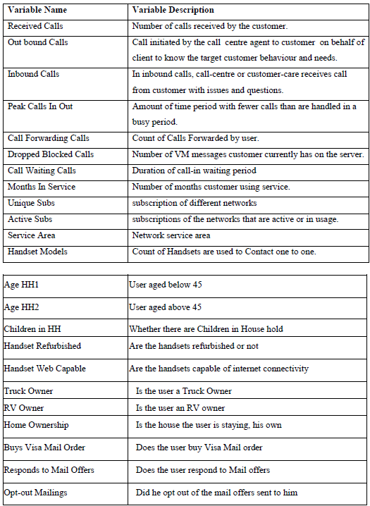
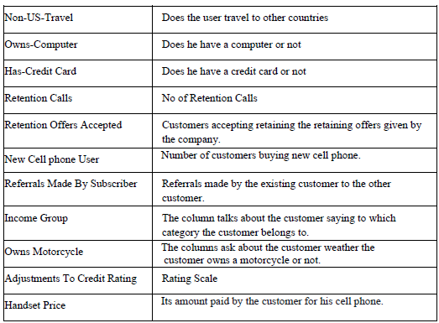

Slide 6
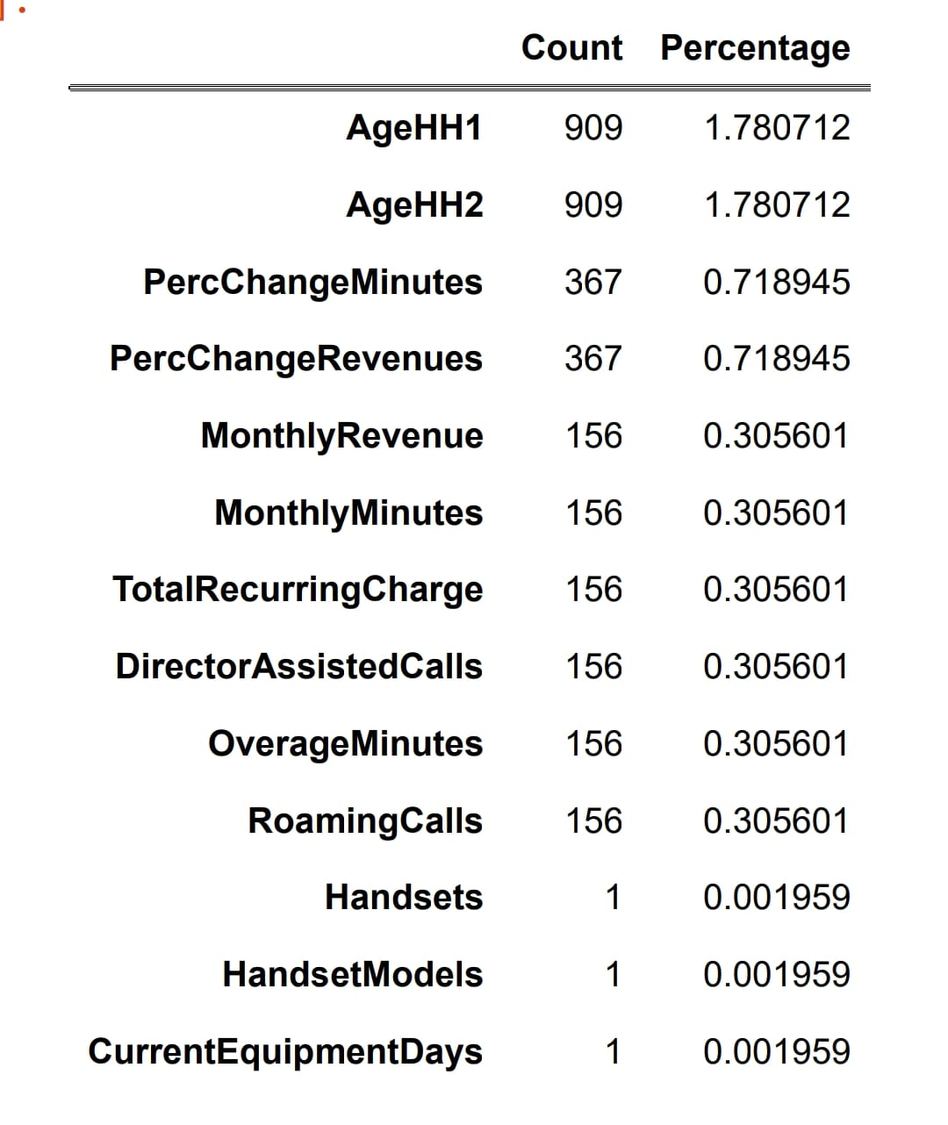
Exploratory Data Analysis (EDA)
Missing Values
Out of 56 features 13 had missing values.
11 of them had less than 1% of missing values, hence the rows were deleted directly.
AgeHH1 and AGEHH2 were treated using median value imputation.

Slide 7
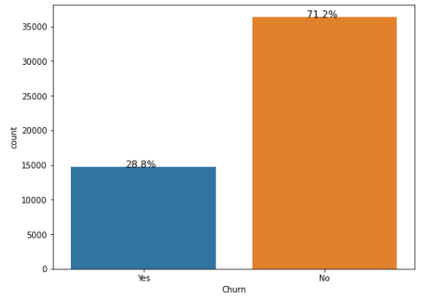
Univariate Analysis
In our data over 28% people have churned ,that is around 14,500 of them.

Slide 8
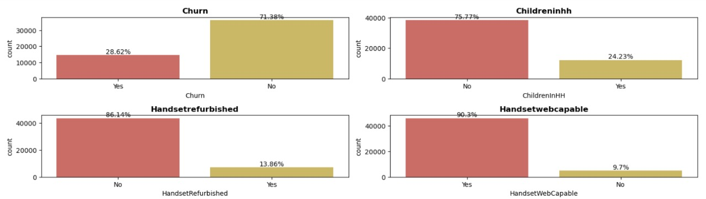
Exploratory Data Analysis (EDA)
Univariate Analysis:
Churn Over 28 percent of people in the data have churned.
2) Handsetwebcapable More than 90 percent of the people in the data have internet support on their phone.

Slide 9
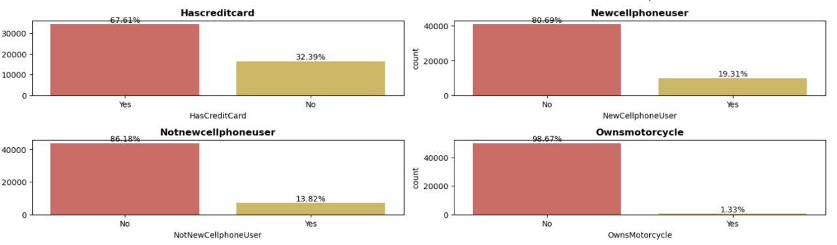
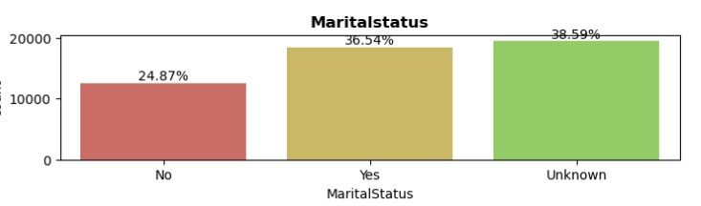
3) More than 65 percent of them don't have a credit card
4) Less than 2 percent of them own a motorcycle
5) More than half of the people's handset price is unknown
6) Over 70 percent of the data has occupations other than the ones mentioned.
7) Martial status of 60 percent of the data is known out of which, 25 percent are not married. The rest are unknown.

Slide 10
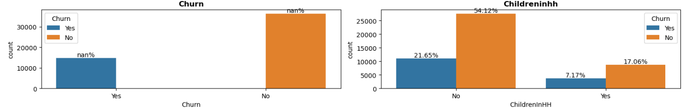
Bivariate and Multivariate Analysis
In Handset web capability over 25% of people who have churned has more than 90% of Internet capability on their phone.
Less than 6% of people who own New phone have churned

Slide 11
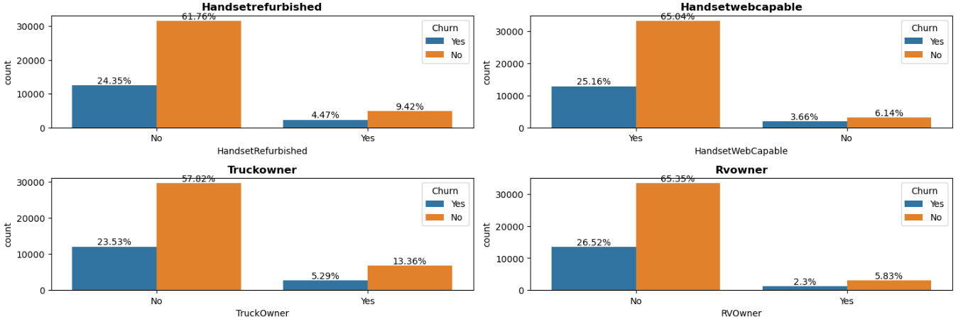
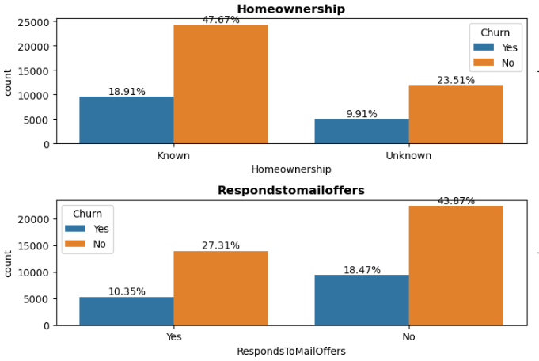
Data show that people who have Credit Cards are more likely to Churn
Marital Status of people churning is independent
People who have responded mail offer are less likely to churn

Slide 12
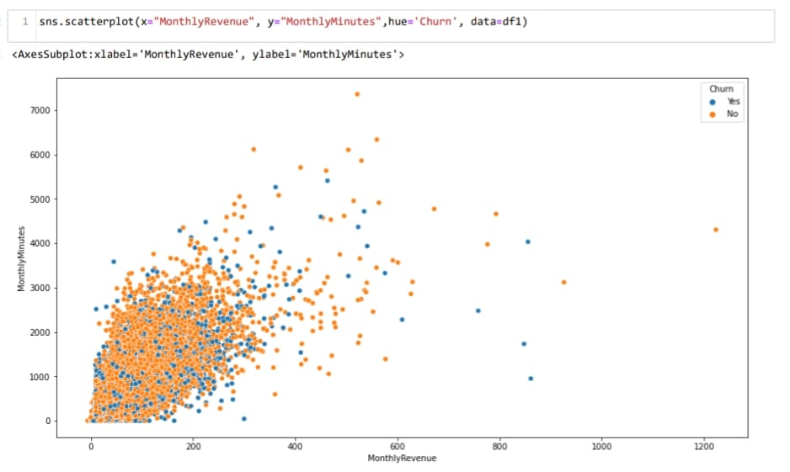
Bivariate and Multivariate Analysis
Observation:
According to plot as Monthly Revenue Increases, Then the number of Monthly Minutes increases, But we can't draw any conclusion on churn

Slide 13
Statistics
Chi-Square Test for Independence :
This test is used to test whether the categorical variables are independent or not.
𝐻0: The variables are independent
𝐻1: The variables are not independent (i.e. variables are dependent)
Here we can check if the categorical features are dependent on our target . We are assuming the level of confidence as 95%
The dependent categorical variable found after Chi-Square Test for Independence are:
ChildrenInHH
HandsetRefurbished
HandsetWebCapable
Homeownership
BuysViaMailOrder
RespondsToMailOffers
MadeCallToRetentionTeam
CreditRating
PrizmCode
MaritalStatus

Slide 14
Statistics
Kruskal Wallis test to check its dependence on the target variable
The null and alternative hypothesis for Kruskal Wallis test is given as:
𝐻0: The data samples are with equal median (independent).
𝐻1: The data samples do not have equal median(i.e. variables are dependent).
Assuming the level of confidence as 95%
The independent numerical variable found after H-test Test:
RoamingCalls
PercChangeRevenues
CallForwarding
CallsHandsetPrice

Slide 15
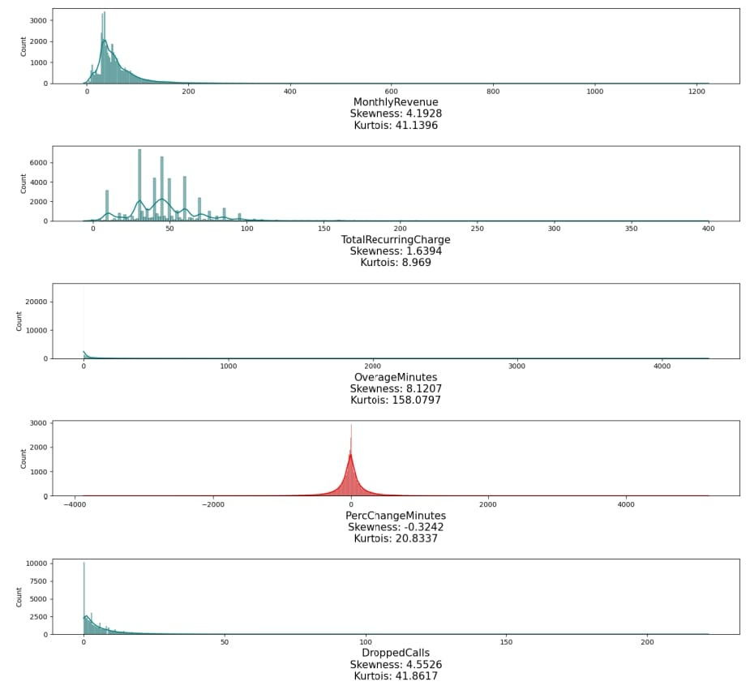
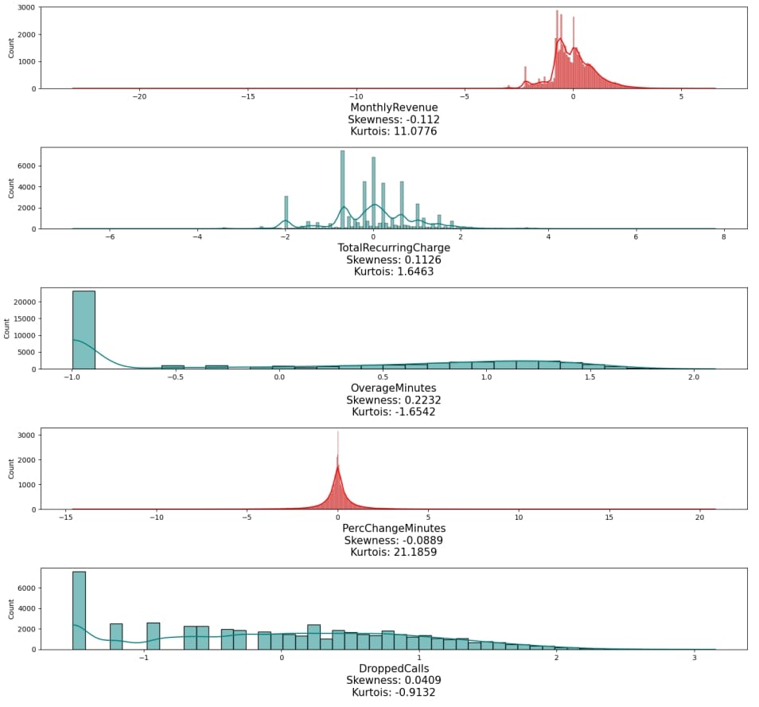
Skewness Before and After Power Transformation

Slide 16
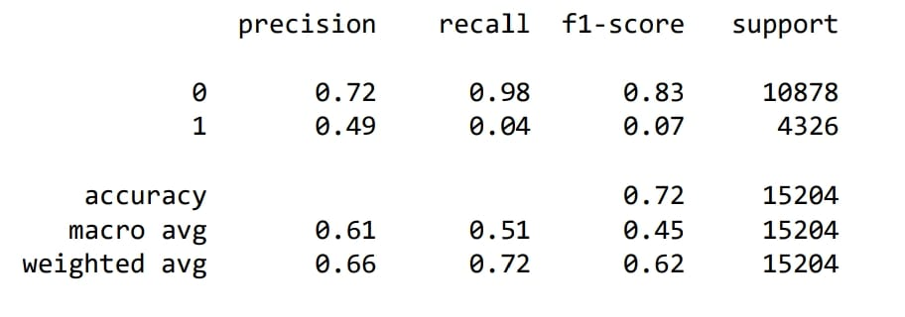
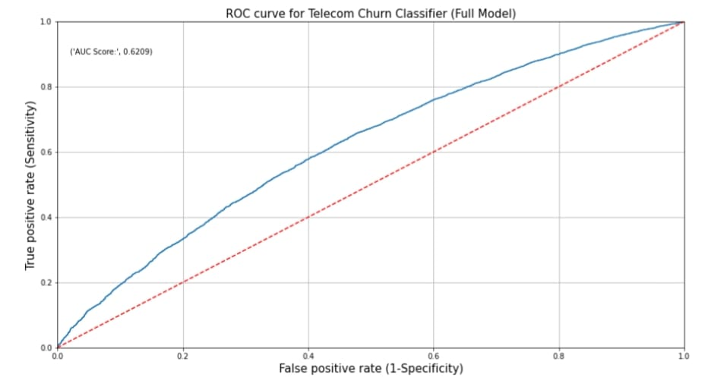
Logistic Regression (Base Model)
Classification Report:
we can infer that the recall of the positive class is known as sensitivity and the recall of the negative class is specificity.
Accuracy of model is 0.72
ROC Curve:
The red dotted line represents the ROC curve of a pure random classifier; a good classifier stays as far away from that line as possible (towards top-left corner).
From the above plot, we can see that our classifier (logistic regression) is away from the dotted line; with the AUC score 0.6209.

Slide 17
Thank You

